Slide 1


CEF 440 INTERNET PROGRAMMING (J2EE) AND MOBILE PROGRAMMING task 1
FACULTY OF ENGINEERING AND TECHNOLOGY
DEPARTMENT OF COMPUTER ENGINEERING
Instructors : DR. VALERY

Slide 2
Group 15
NO | NAMES | MATRICULE | SPECIALTY
01 | KONGNYUY RAYMOND AFONI | FE21A219 | NE
02 | BESSONG ELIAS ASUMU | FE21A149 | SE
03 | KANKO KEMEDJEU DUPLEX | FE21A210 | NE
04 | KENEDY MALLEY ITUKA | FE21A212 | NE
05 | AZEFACK JUNIOR | FE21A146 | NE

Slide 3



1. Review and compare the major types of mobile apps and their differences
Native app
Hybrid app
PWAs app
are built for a specific platform or device type. The user must install the appropriate software version on their device of choice.
are native applications with a web browser embedded inside them.
are delivered over an internet browser. Users don't need to install them on their devices.

Slide 4
Comparison
Characteristics | PWAs app | Hybrid app | Native app
Usage | Users can access directly from a browser | Users have to install the app on their device of choice | Users have to install the app on their device of choice
Internal working | Client code in the browser communicates with remote server-side code and databases | Client code and browser code wrapped in a native shell or container | Client code written in technology and language specific to the device or platform it will be installed on
Native device features | Not accessible | Accessible | Accessible
User experience | Inconsistent and dependent on the browser being used | Consistent and engaging | Consistent and engaging
Access | Limited by browser and network connectivity | One-step access with offline features | One-step access with offline features
Performance | Slower and less responsive | Faster, but may consume more battery power | Performance can be optimized to device
Development | Cost-efficient, faster time to market | Cost-efficient, faster time to market | Expensive, slower time to market

Slide 5


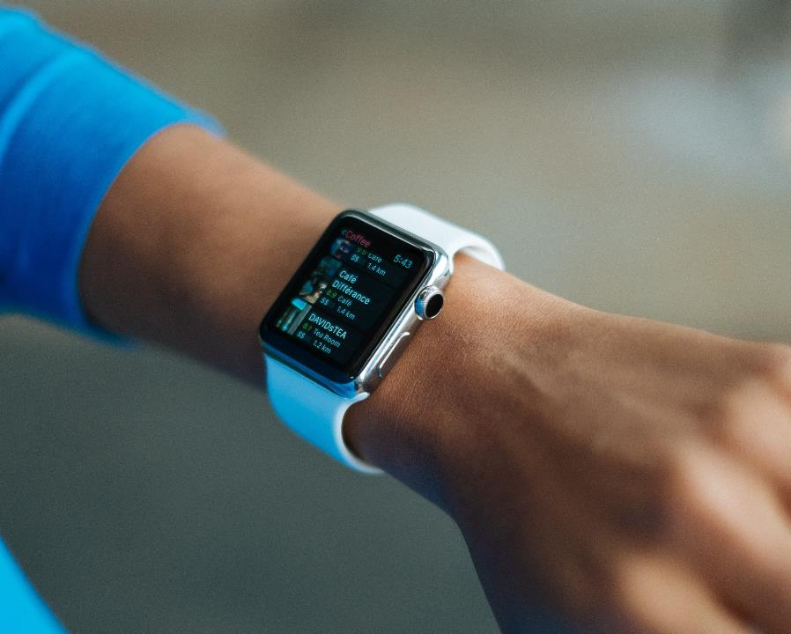

Choosing the Right Option: Native Apps: Ideal for complex apps requiring full device functionality and top-notch UX ( games, photo editing). PWAs: Great for simpler apps, news outlets, or when you need a fast and cost-effective solution with offline capabilities. Hybrid Apps: A good option if you need an app for both iOS and Android with a balance between development speed and features.
target audience
desired features
your budget
development timeline

Slide 6
2. Reviewing and Comparing Mobile App Programming Languages
Choosing the right programming language for your mobile app development project is crucial
Swift
Kotlin
Java
Developed by Apple, swift is the go-to language for iOS app development. Its clean syntax and powerful features make it easy to write and maintain code.
Kotlin has gained popularity for Android app development due to its interoperability with Java and concise syntax. It offers features like null safety and extension functions, enhancing productivity and code safety.
As a long-standing player in the mobile app development scene, java remains a robust choice for Android app development
Its platform independence, strong community support, and extensive libraries make it a versatile language

Slide 7
Dart
JavaScript
C#
Dart, paired with Google’s Flutter framework, enables cross-platform app development with native-like performance.
Its Just-in-Time compilation allows for fast development cycles, while Ahead-of-Time compilation ensures efficient production builds.
Allows developers to build native Android, iOS, and Windows apps with a shared codebase.
Its strong integration with Visual Studio and access to native APIs ensure high performance and platform-specific functionalities. Apps like UPS and Alaska Airlines rely on Xamarin for its code-sharing capabilities and native user experiences.
React Native leverages JavaScript to build cross-platform mobile apps with a single codebase. Its component-based architecture and hot reloading feature accelerate development.
Popular apps like Facebook and Instagram use React Native for their ability to deliver native-like performance and seamless user experiences a cross platforms.

Slide 8
Objective-C
Python
While Swift has largely replaced Objective-C for iOS development, it remains relevant for maintaining legacy codebases.
Objective-C offers dynamic messaging and runtime reflection, allowing for flexible app development. Apps like Airbnb and Uber initially relied on Objective-C before transitioning to Swift.
Python’s simplicity and versatility extend to mobile app development, particularly with frameworks like Kivy and BeeWare.
Its readable syntax and extensive libraries facilitate rapid prototyping and development. Apps like Instagram and Dropbox use Python for backend services and automation tasks, showcasing its flexibility beyond mobile development.

Slide 9

Choosing the Right Language:
It is essential to prioritize versatility, platform compatibility, performance, and security.
Python stands out for its adaptability.
gains ground for Android app development over Java.
JavaScript excels in creating both websites and mobile apps.
Swift remains the go-to choice for iOS app development
Java remains strong for cross-platform and corporate applications.
Rust emerges as a formidable option for its combination of performance and security.
Conclusion:
There's no one-size-fits-all solution. By understanding the strengths and weaknesses of each language and its suitability for your project requirements, you can make an informed decision that optimizes development time, cost, and user experience.

Slide 10
3. Review and compare mobile app development frameworks by comparing their key features and where they can be used.
Swift (Native)
Swift (Native)
Kotlin Native
Kotlin Native
Xamarin
Xamarin
Language: Native (Swift)
Performance: Excellent (Native)
Cost & Time to Market: Lower (Native development)
UX & UI: Flexible (Native UI components)
Complexity: High (Native development complexity)
Language: Native (Kotlin)
Performance: Excellent (Native)
Cost & Time to Market: Lower (Native development)
UX & UI: Flexible (Native UI components)
Complexity: High (Native development complexity)
Language: C#
Performance: Excellent (Native-like)
Cost & Time to Market: Moderate (Higher development cost)
UX & UI: Flexible (Native UI components)
Complexity: Moderate (C# knowledge needed)

Slide 11
Ionic
Ionic
React Native
React Native
Flutter
Flutter
Language: Web technologies (HTML, CSS, JS)
Performance: Good (Web-based)
Cost & Time to Market: Lower (Faster development)
UX & UI: Limited (Web-like UI)
Complexity: Lower (Web development skills)
Language: JavaScript
Performance: Excellent (Native-like)
Cost & Time to Market: Moderate (Faster development)
UX & UI: Flexible (Customizable UI)
Complexity: Moderate (Learning curve)
Language: Dart
Performance: Excellent (Native-like)
Cost & Time to Market: Moderate (Faster development)
UX & UI: Flexible (Customizable UI)
Complexity: Moderate (Learning Dart)

Slide 12

Choosing the Ideal Framework:
. Here's a quick guide:
Complex, high-performance native apps: Prioritize native development frameworks like Swift or Kotlin Native.
Enterprise-level cross-platform apps: Consider Xamarin's established nature and familiarity for C# developers.
Simple to moderately complex cross-platform apps: Explore React Native, Flutter, or Ionic for their development speed and cross-platform capabilities.

Slide 13

28
4. mobile application architectures and design patterns
structured approach to building mobile apps, promoting reusability, maintainability, and efficiency

Slide 14
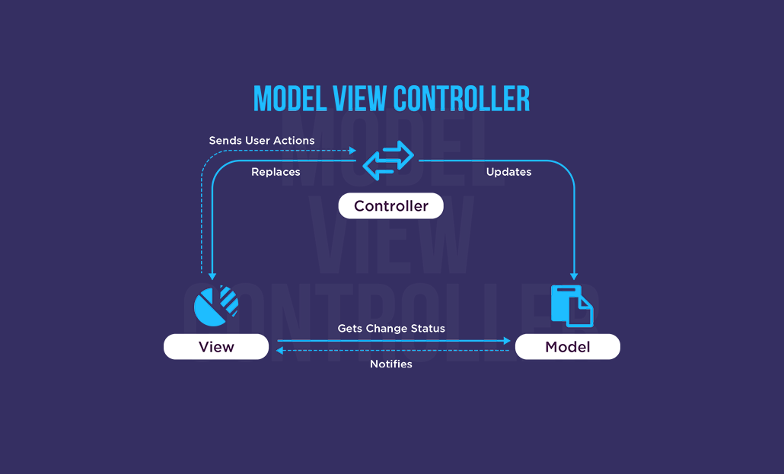
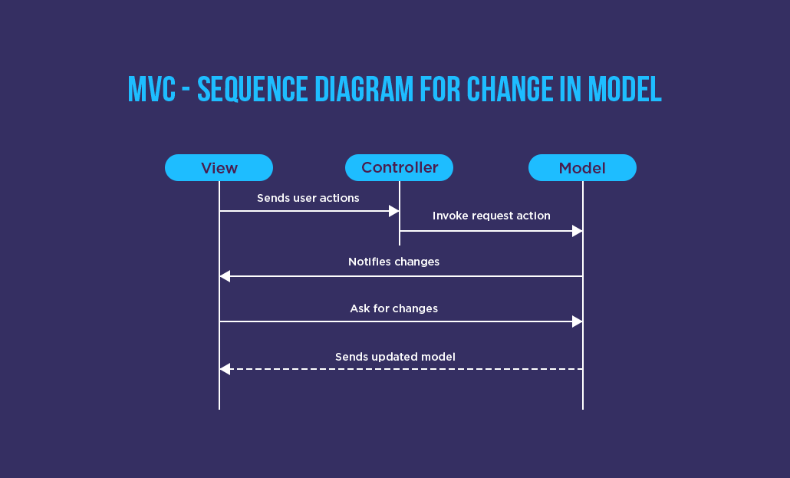
a. Model-View-Controller (MVC):
Separates app logic, UI, and user interaction (good for simple apps).

Slide 15
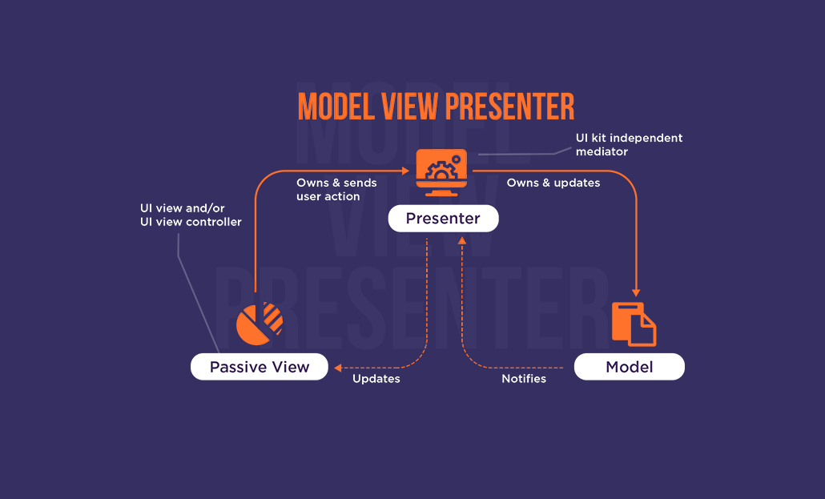
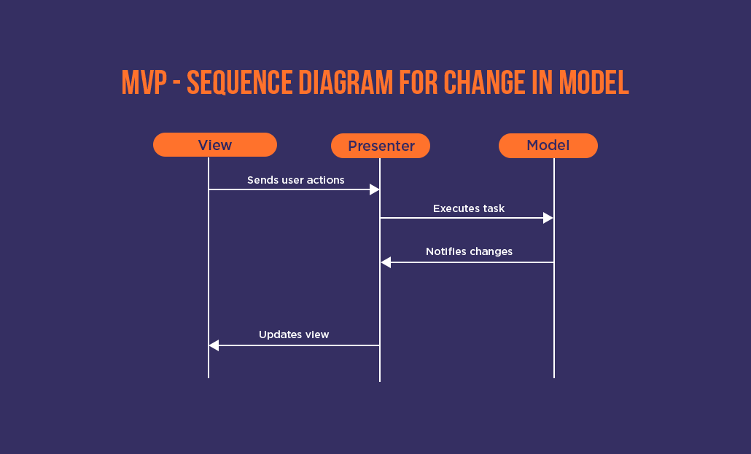
b. MVP (Model-View-Presenter):
Similar to MVP separates concerns but uses a Presenter component to handle business logic and data presentation for the View. This pattern can be useful for complex user interactions. Introduced in the 1990s.

Slide 16
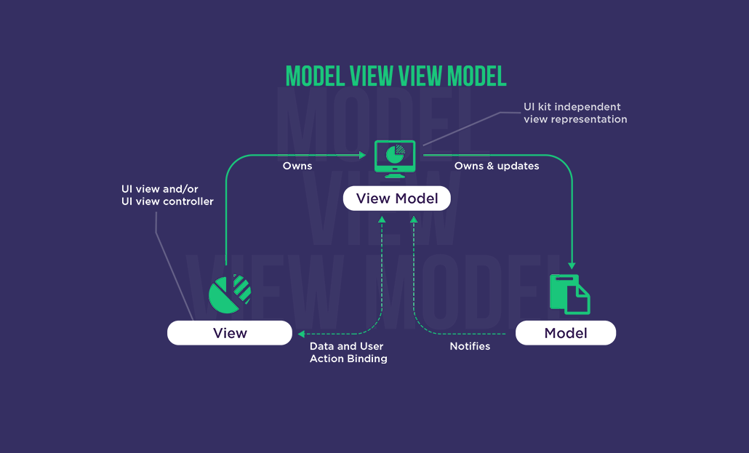
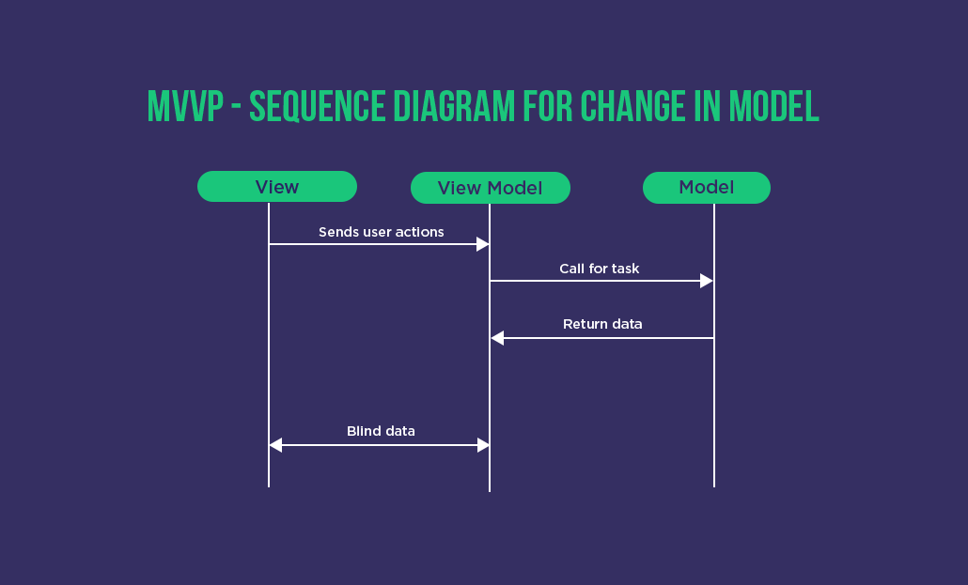
c. Model-View-ViewModel (MVVM):
Uses ViewModel to simplify View and handle interactions. The ViewModel prepares data for the View and handles user interactions without complex logic in the View itself. This is a popular pattern for mobile development frameworks like Android's Jetpack.

Slide 17
Other Important Patterns: - Singleton: Ensures one instance of a class (cautious use). - Adapter: Makes incompatible interfaces work together. - VIPER (New): Strict separation of concerns with five layers (View, Interactor, Presenter, Entity, Router).

Slide 18
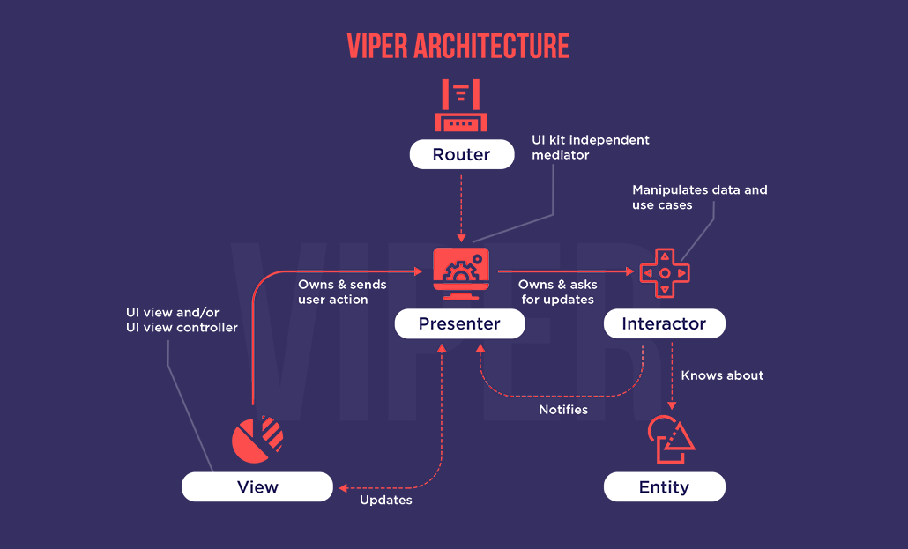
Choosing a Pattern: Consider app complexity, maintainability needs, reusability, and developer familiarity.

Slide 19
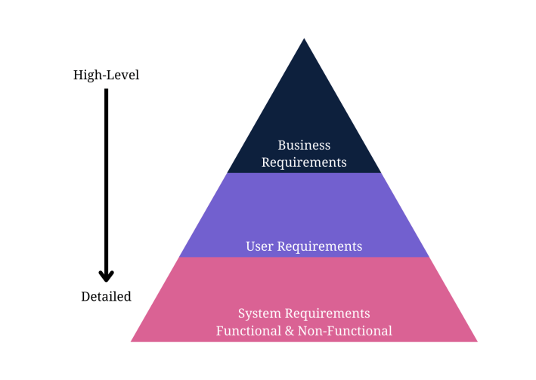
5. How to collect and analyze user requirements for a mobile application (Requirement Engineering)

Slide 20
1. Define App Idea & Purpose: Identify the problem your app solves and its business goals. 2. Gather & Align App & Business Objectives: Identify stakeholders, define goals, and document requirements. 3. Run Market & Competitor Analysis: Understand user needs and competitor strengths/weaknesses. 4. Determine User Persona Scenarios: Create a profile of your ideal user.

Slide 21
5. Gather & Prioritize Requirements: Identify functional (what the app does) and non-functional (performance, security) requirements. 6. Design Use Cases & UML Diagrams: Create visual representations of app functionality.Write an App Requirements Document: Document all requirements for development.
7. Deploy Prototyping & Wireframing: Design user interface and test layouts.

Slide 22
8. Validate the App Requirements: Get feedback on the prototype to ensure it meets requirements.
9. Apply Agile Methodology: Continuously adapt requirements based on feedback.

Slide 23
6. Study how to estimate mobile app development cost.
Mobile App Development Cost Breakdown
Initial Phases: Plan well (low cost) & design effectively (mod. cost) to minimize expensive rework later. Development & infrastructure (high cost) is the most time-consuming stage. Testing (mod. cost) is crucial to avoid costly bug fixes. Publishing (low cost) has separate marketing expenses.

Slide 24
Ongoing Costs:
Expect 15-20% annually for maintenance (especially in year 1) to cover hosting, support, updates, etc.
Costs for Long-Term success:
Factor in user acquisition, app localization, legal/licensing fees., and future development needs.
Cost Influencers:
Development approach: Traditional (expensive, flexible), No-code (cheap, limited), Low-code (balance).
App complexity: More features(like payments, social media feeds) = higher cost.

Slide 25
28
Target platform: Developing for both iOS & Android is more expensive.
Your team: Team size, skills, and location(multilanguage) all affect cost.
Contract type (fixed term vs. ongoing hourly, daily payments )
Remember: Consider the entire app lifecycle cost, not just development, to make informed decisions and find the right development partner for your app's success.

Slide 26


Thank You
GROUP 15
GitHub - Asumu22/group-15

